Slide 1
(Some) Applications of DFS
Data Structures and Algorithms
Nanjing University, Fall 2020
郑朝栋

Slide 2
Directed Acyclic Graphs (DAG)
A graph without cycles is called acyclic.
A directed graph without cycles is a directed acyclic graph (DAG).
DAGs are good for modeling relations such as: causalities, hierarchies, and temporal dependencies.
Cyclic
Acyclic
Cyclic
DAG
A
B
A
B
A
B
A
B
D
C
D
C
D
C
D
C

Slide 3
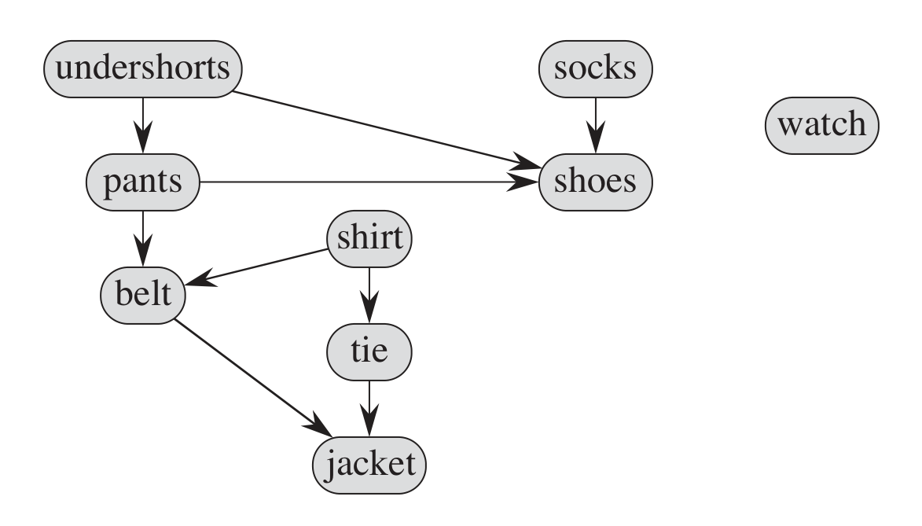
Application of DAG
DAGs are good for modeling relations such as: causalities, hierarchies, and temporal dependencies.
Example:
Consider how you get dressed in the morning.
Must don certain garments before others (e.g., socks before shoes).
Other items may be put on in any order (e.g., socks and pants).
This process can be modeled by a DAG!
What is a valid order to perform all the task?

Slide 4
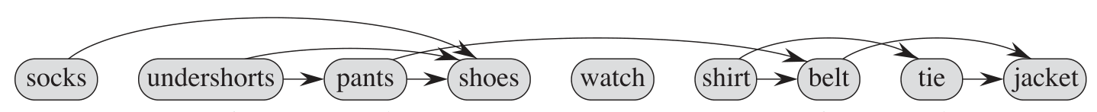
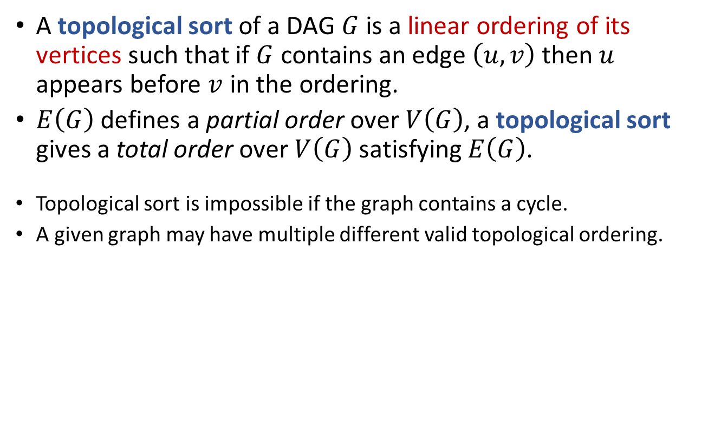
Topological Sort
A topological sort of a DAG $G$ is a linear ordering of its vertices such that if $G$ contains an edge $\left(u,v\right)$ then $u$ appears before $v$ in the ordering.
$E\left(G\right)$ defines a partial order over $V\left(G\right)$, a topological sort gives a total order over $V\left(G\right)$ satisfying $E\left(G\right)$.
Topological sort is impossible if the graph contains a cycle.
A given graph may have multiple different valid topological ordering.
How to generate a topological ordering?
A topological ordering arranges the vertices along a horizontal line so that all edges go “from left to right”.

Slide 5




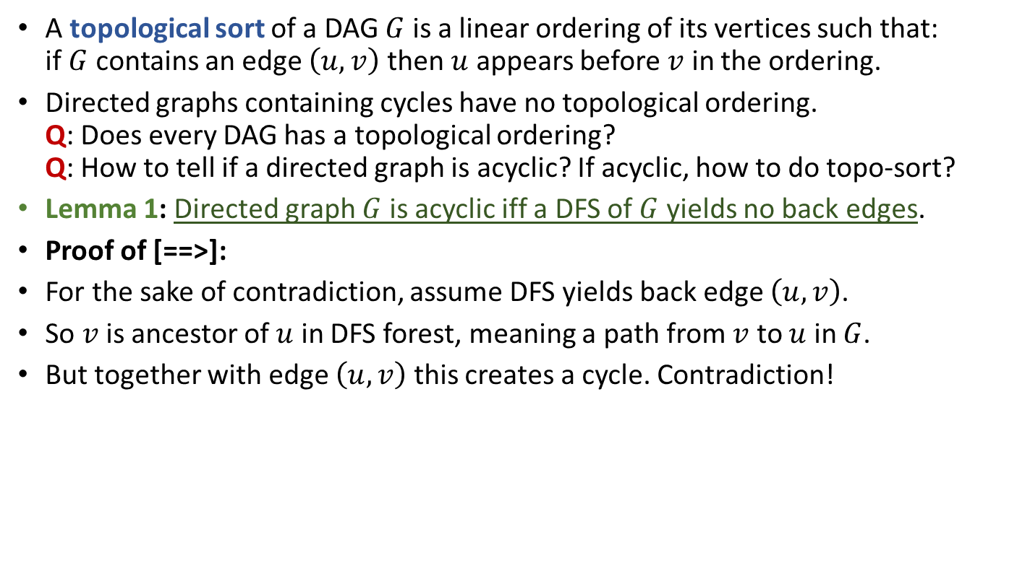
Topological Sort
A topological sort of a DAG $G$ is a linear ordering of its vertices such that: if $G$ contains an edge $\left(u,v\right)$ then $u$ appears before $v$ in the ordering.
Directed graphs containing cycles have no topological ordering. Q: Does every DAG has a topological ordering? Q: How to tell if a directed graph is acyclic? If acyclic, how to do topo-sort?
Lemma 1: Directed graph $G$ is acyclic iff a DFS of $G$ yields no back edges.
Proof of [==>]:
For the sake of contradiction, assume DFS yields back edge $\left(u,v\right)$.
So $v$ is ancestor of $u$ in DFS forest, meaning a path from $v$ to $u$ in $G$.
But together with edge $\left(u,v\right)$ this creates a cycle. Contradiction!
$$v$$
$$v_{1}$$
$$v_{2}$$
……
$$u$$

Slide 6



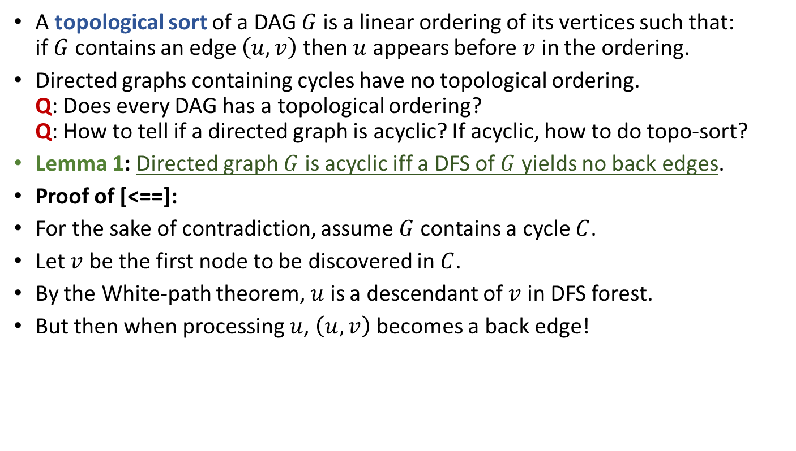
Topological Sort
A topological sort of a DAG $G$ is a linear ordering of its vertices such that: if $G$ contains an edge $\left(u,v\right)$ then $u$ appears before $v$ in the ordering.
Directed graphs containing cycles have no topological ordering. Q: Does every DAG has a topological ordering? Q: How to tell if a directed graph is acyclic? If acyclic, how to do topo-sort?
Lemma 1: Directed graph $G$ is acyclic iff a DFS of $G$ yields no back edges.
Proof of [<==]:
For the sake of contradiction, assume $G$ contains a cycle $C$.
Let $v$ be the first node to be discovered in $C$.
By the White-path theorem, $u$ is a descendant of $v$ in DFS forest.
But then when processing $u$, $\left(u,v\right)$ becomes a back edge!
$$v$$
$$u$$
$$v_{1}$$
……

Slide 7
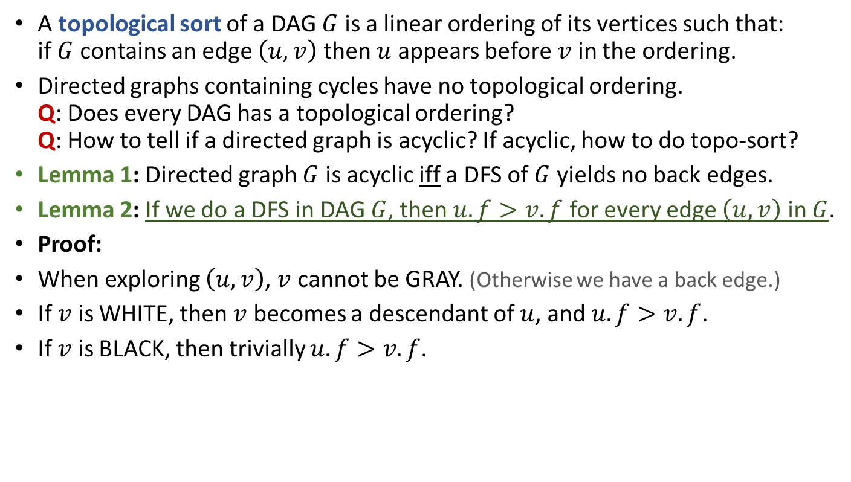
Topological Sort
A topological sort of a DAG $G$ is a linear ordering of its vertices such that: if $G$ contains an edge $\left(u,v\right)$ then $u$ appears before $v$ in the ordering.
Directed graphs containing cycles have no topological ordering. Q: Does every DAG has a topological ordering? Q: How to tell if a directed graph is acyclic? If acyclic, how to do topo-sort?
Lemma 1: Directed graph $G$ is acyclic iff a DFS of $G$ yields no back edges.
Lemma 2: If we do a DFS in DAG $G$, then $u.f>v.f$ for every edge $\left(u,v\right)$ in $G$.
Proof:
When exploring $\left(u,v\right)$, $v$ cannot be GRAY. (Otherwise we have a back edge.)
If $v$ is WHITE, then $v$ becomes a descendant of $u$, and $u.f>v.f$.
If $v$ is BLACK, then trivially $u.f>v.f$.

Slide 8

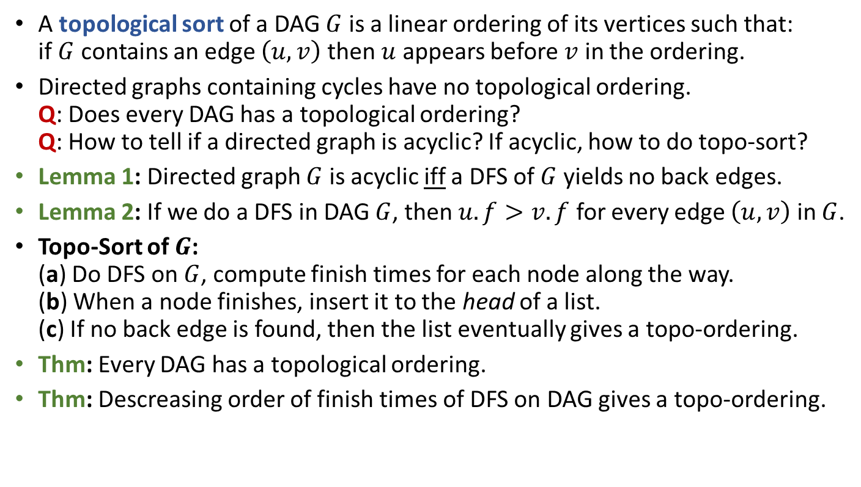
Topological Sort
A topological sort of a DAG $G$ is a linear ordering of its vertices such that: if $G$ contains an edge $\left(u,v\right)$ then $u$ appears before $v$ in the ordering.
Directed graphs containing cycles have no topological ordering. Q: Does every DAG has a topological ordering? Q: How to tell if a directed graph is acyclic? If acyclic, how to do topo-sort?
Lemma 1: Directed graph $G$ is acyclic iff a DFS of $G$ yields no back edges.
Lemma 2: If we do a DFS in DAG $G$, then $u.f>v.f$ for every edge $\left(u,v\right)$ in $G$.
Topo-Sort of $G$: (a) Do DFS on $G$, compute finish times for each node along the way. (b) When a node finishes, insert it to the head of a list. (c) If no back edge is found, then the list eventually gives a topo-ordering.
Thm: Every DAG has a topological ordering.
Thm: Descreasing order of finish times of DFS on DAG gives a topo-ordering.
Time complexity is $O\left(n+m\right)$.

Slide 9
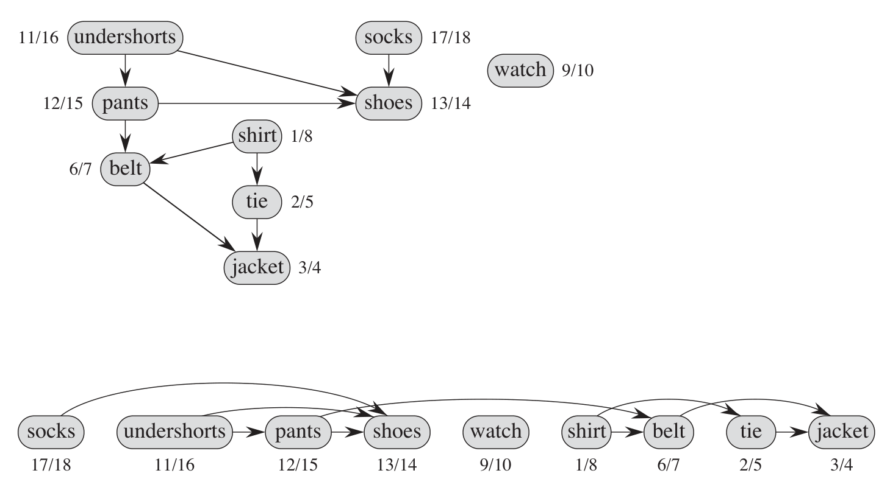
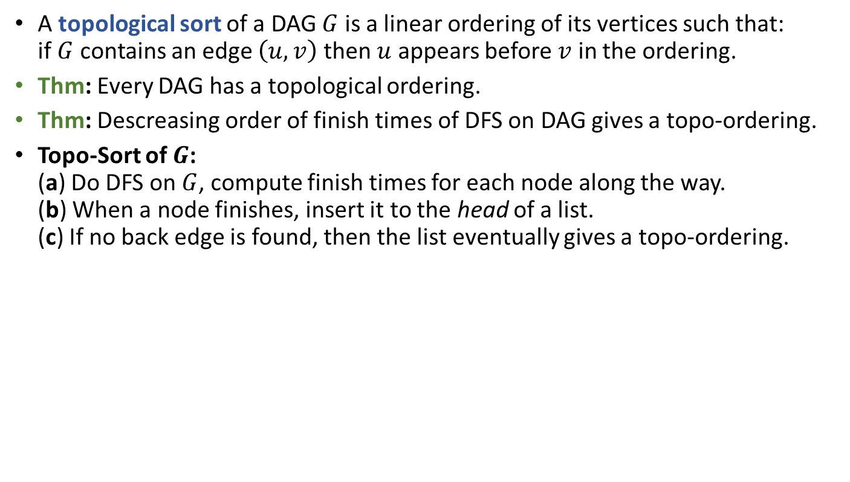
Topological Sort
A topological sort of a DAG $G$ is a linear ordering of its vertices such that: if $G$ contains an edge $\left(u,v\right)$ then $u$ appears before $v$ in the ordering.
Thm: Every DAG has a topological ordering.
Thm: Descreasing order of finish times of DFS on DAG gives a topo-ordering.
Topo-Sort of $G$: (a) Do DFS on $G$, compute finish times for each node along the way. (b) When a node finishes, insert it to the head of a list. (c) If no back edge is found, then the list eventually gives a topo-ordering.

Slide 10
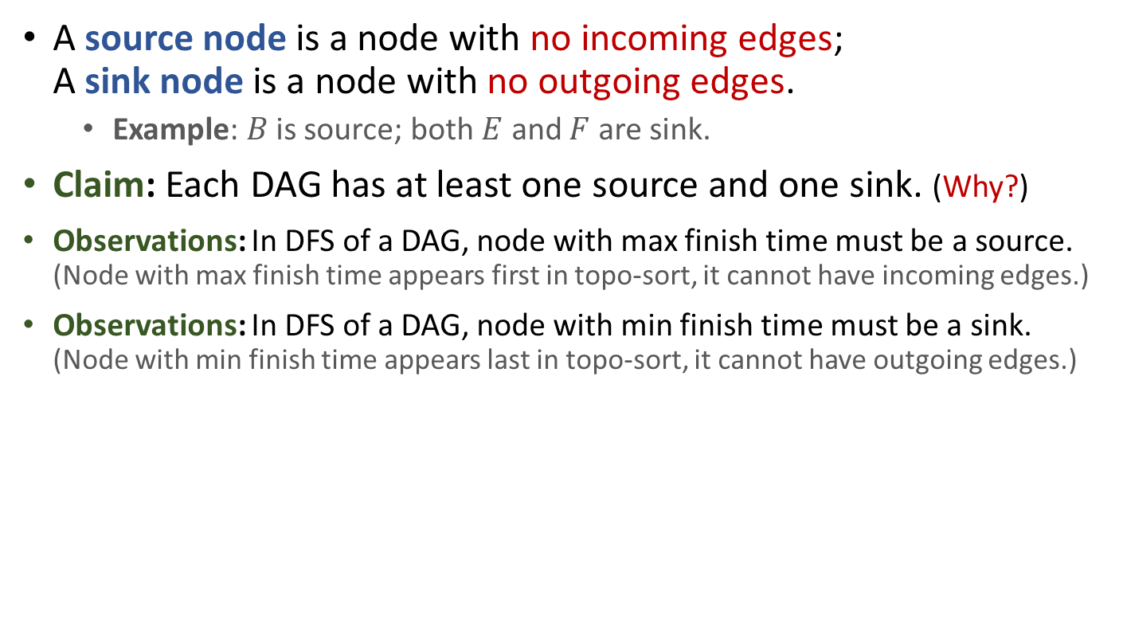
Source and Sink in DAG
A source node is a node with no incoming edges; A sink node is a node with no outgoing edges.
Example: $B$ is source; both $E$ and $F$ are sink.
Claim: Each DAG has at least one source and one sink. (Why?)
Observations: In DFS of a DAG, node with max finish time must be a source. (Node with max finish time appears first in topo-sort, it cannot have incoming edges.)
Observations: In DFS of a DAG, node with min finish time must be a sink. (Node with min finish time appears last in topo-sort, it cannot have outgoing edges.)
A
C
E
B
D
F

Slide 11
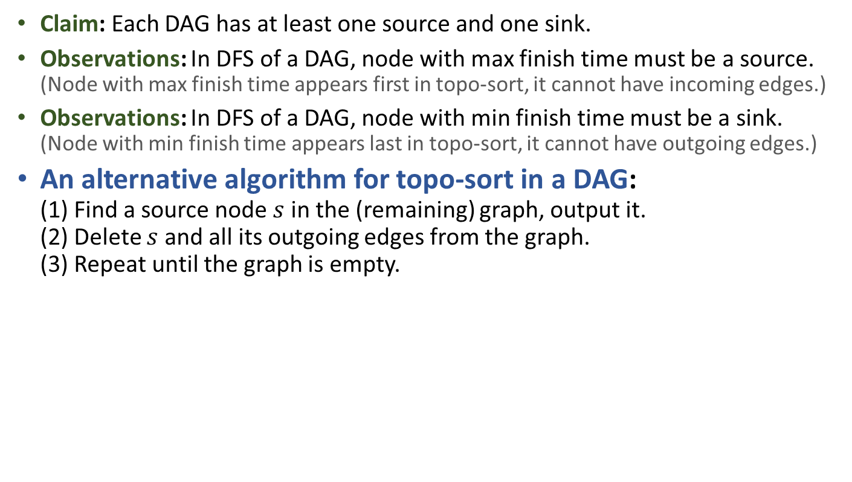
Alt Algorithm for Topo-Sort
Claim: Each DAG has at least one source and one sink.
Observations: In DFS of a DAG, node with max finish time must be a source. (Node with max finish time appears first in topo-sort, it cannot have incoming edges.)
Observations: In DFS of a DAG, node with min finish time must be a sink. (Node with min finish time appears last in topo-sort, it cannot have outgoing edges.)
An alternative algorithm for topo-sort in a DAG: (1) Find a source node $s$ in the (remaining) graph, output it. (2) Delete $s$ and all its outgoing edges from the graph. (3) Repeat until the graph is empty.
Formal proof of correctness? How efficient can you implement it?
A
C
E
B
A
D
C
E
F
B
D
F

Slide 12
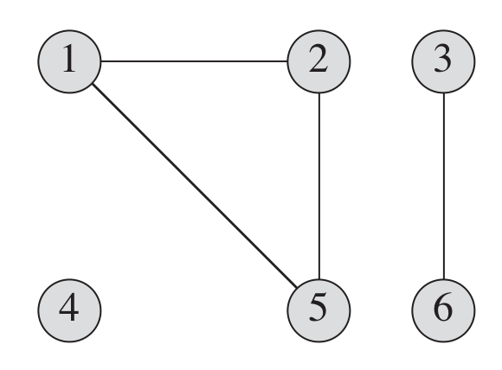
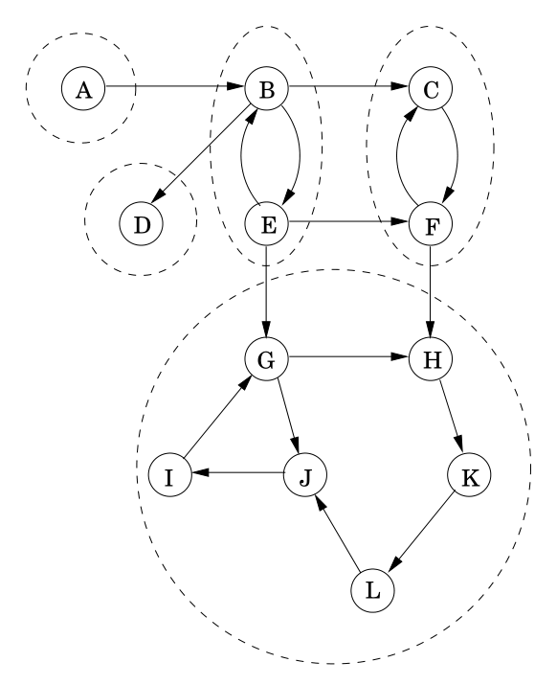
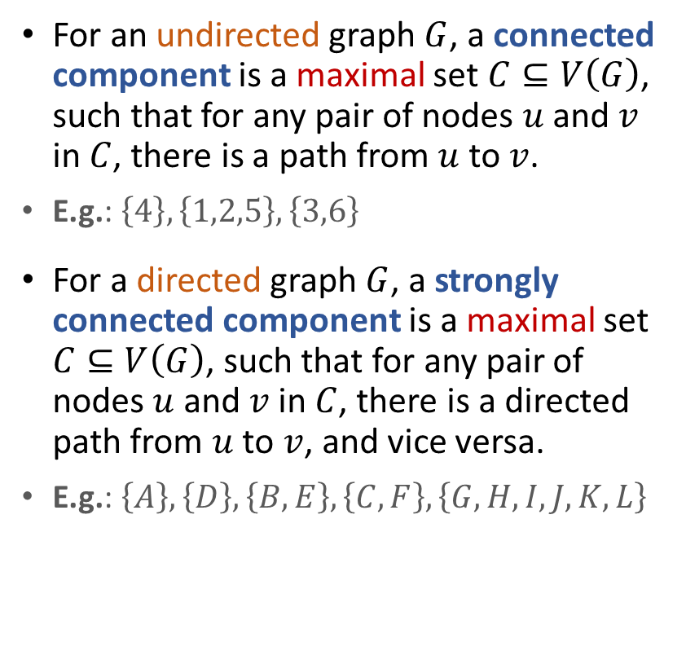
(Strongly) Connected Components
For an undirected graph $G$, a connected component is a maximal set $C⊆V\left(G\right)$, such that for any pair of nodes $u$ and $v$ in $C$, there is a path from $u$ to $v$.
E.g.: $\left\{4\right\},\left\{1,2,5\right\},\left\{3,6\right\}$
For a directed graph $G$, a strongly connected component is a maximal set $C⊆V\left(G\right)$, such that for any pair of nodes $u$ and $v$ in $C$, there is a directed path from $u$ to $v$, and vice versa.
E.g.: $\left\{A\right\},\left\{D\right\},\left\{B,E\right\},\left\{C,F\right\},\left\{G,H,I,J,K,L\right\}$

Slide 13
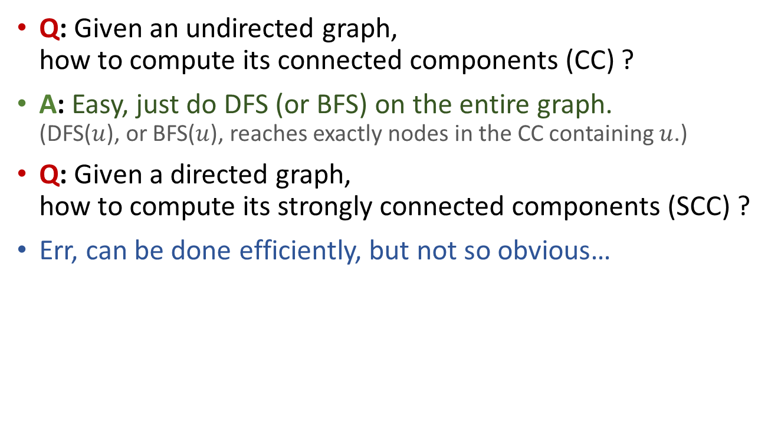
Computing CC and SCC
Q: Given an undirected graph, how to compute its connected components (CC) ?
A: Easy, just do DFS (or BFS) on the entire graph. (DFS($u$), or BFS($u$), reaches exactly nodes in the CC containing $u$.)
Q: Given a directed graph, how to compute its strongly connected components (SCC) ?
Err, can be done efficiently, but not so obvious…

Slide 14
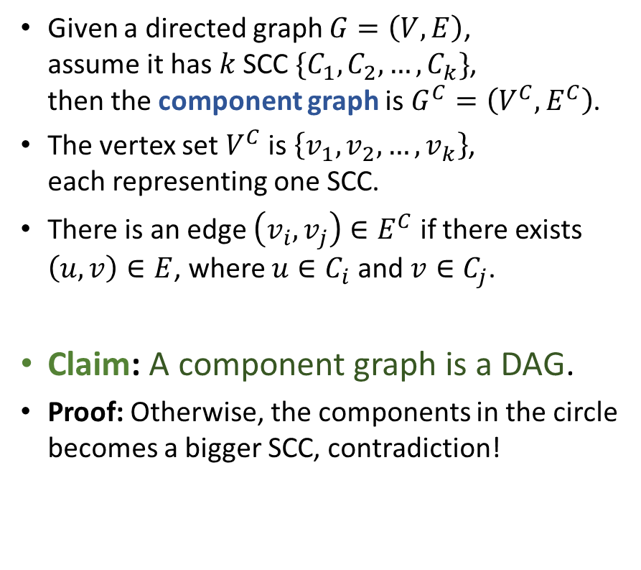
Component Graph
Given a directed graph $G=\left(V,E\right)$, assume it has $k$ SCC $\{C_{1},C_{2},…,C_{k}\}$, then the component graph is $G^{C}=\left(V^{C},E^{C}\right)$.
The vertex set $V^{C}$ is $\left\{v_{1},v_{2},…,v_{k}\right\}$, each representing one SCC.
There is an edge $\left(v_{i},v_{j}\right)∈E^{C}$ if there exists $\left(u,v\right)∈E$, where $u∈C_{i}$ and $v∈C_{j}$.
Claim: A component graph is a DAG.
Proof: Otherwise, the components in the circle becomes a bigger SCC, contradiction!
A
B,E
C,F
G,H,I J,K,L
D

Slide 15
Computing SCC
A component graph is a DAG.
Each DAG has at least one source and one sink.
If we start from a node in a sink SCC, then we explore exactly nodes in that SCC and stop! (Due to the white-path theorem.)
A good start, but two problems exist:
(1) How to identify a node that is in a sink SCC?
(2) What to do when the first SCC is done?
A
B,E
C,F
G,H,I J,K,L
D

Slide 16



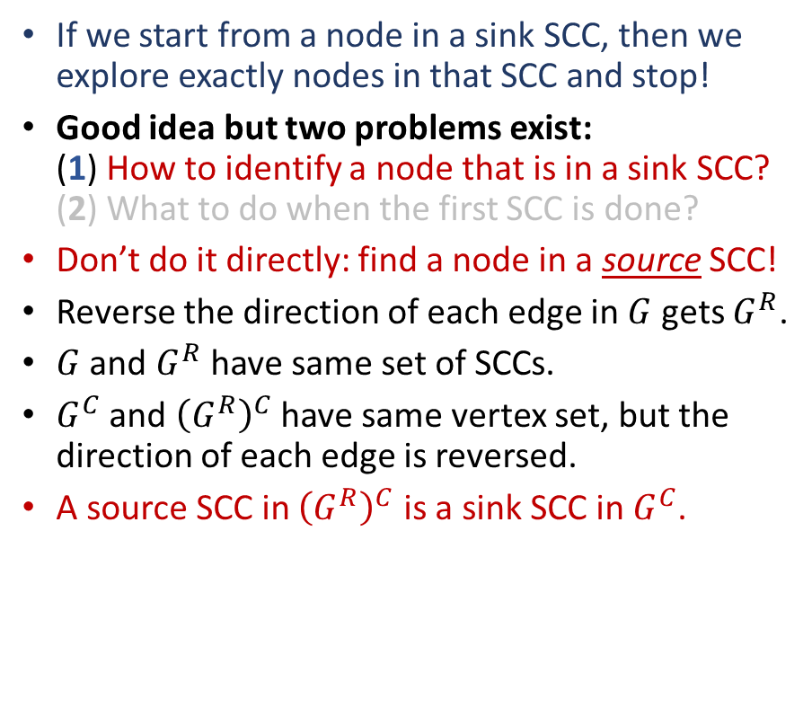
Computing SCC
If we start from a node in a sink SCC, then we explore exactly nodes in that SCC and stop!
Good idea but two problems exist: (1) How to identify a node that is in a sink SCC? (2) What to do when the first SCC is done?
Don’t do it directly: find a node in a source SCC!
Reverse the direction of each edge in $G$ gets $G^{R}$.
$G$ and $G^{R}$ have same set of SCCs.
$G^{C}$ and ${\left(G^{R}\right)}^{C}$ have same vertex set, but the direction of each edge is reversed.
A source SCC in ${\left(G^{R}\right)}^{C}$ is a sink SCC in $G^{C}$.
$$G$$
A
B,E
C,F
A
B,E
C,F
G,H,I J,K,L
G,H,I J,K,L
D
$${\left(G^{R}\right)}^{C}$$
D
$$G^{C}$$

Slide 17



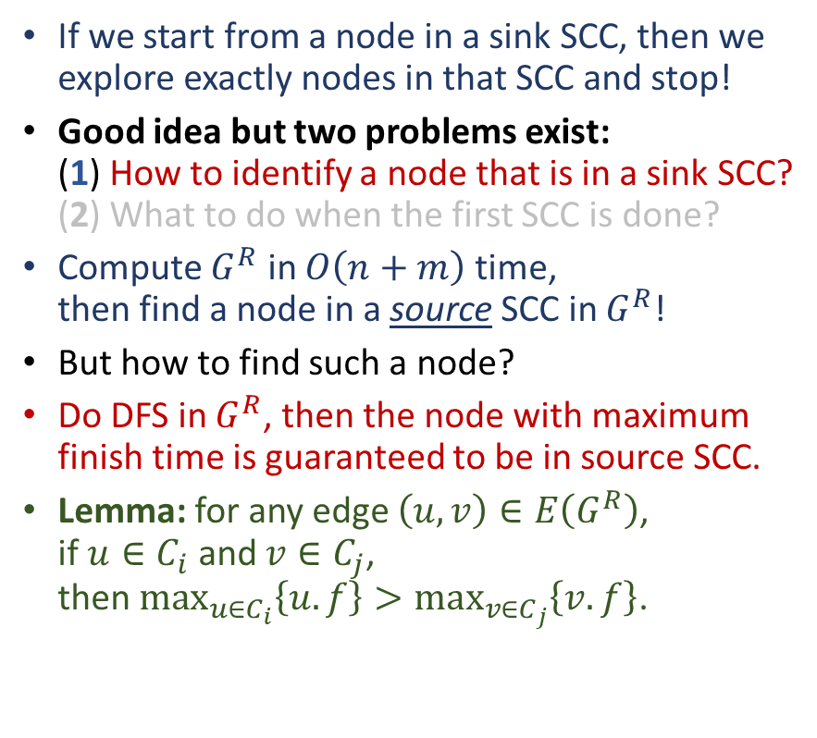
Computing SCC
If we start from a node in a sink SCC, then we explore exactly nodes in that SCC and stop!
Good idea but two problems exist: (1) How to identify a node that is in a sink SCC? (2) What to do when the first SCC is done?
Compute $G^{R}$ in $O\left(n+m\right)$ time, then find a node in a source SCC in $G^{R}$!
But how to find such a node?
Do DFS in $G^{R}$, then the node with maximum finish time is guaranteed to be in source SCC.
Lemma: for any edge $\left(u,v\right)∈E\left(G^{R}\right)$, if $u∈C_{i}$ and $v∈C_{j}$, then $\max_{u∈C_{i}}\left\{u.f\right\}>\max_{v∈C_{j}}\left\{v.f\right\}$.
$$G$$
A
B,E
C,F
G,H,I J,K,L
D
$$G^{C}$$
A
B,E
C,F
G,H,I J,K,L
D
$${\left(G^{R}\right)}^{C}$$

Slide 18
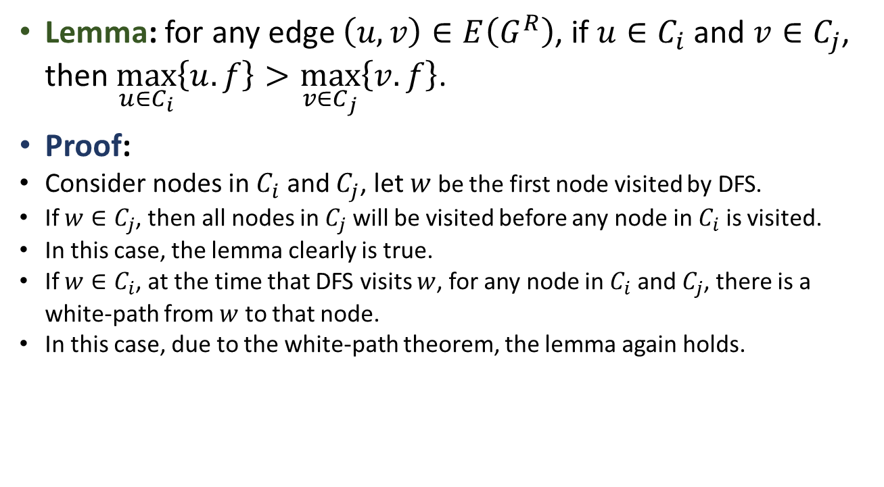
Computing SCC
Lemma: for any edge $\left(u,v\right)∈E\left(G^{R}\right)$, if $u∈C_{i}$ and $v∈C_{j}$, then $\max_{u∈C_{i}}\left\{u.f\right\}>\max_{v∈C_{j}}\left\{v.f\right\}$.
Proof:
Consider nodes in $C_{i}$ and $C_{j}$, let $w$ be the first node visited by DFS.
If $w∈C_{j}$, then all nodes in $C_{j}$ will be visited before any node in $C_{i}$ is visited.
In this case, the lemma clearly is true.
If $w∈C_{i}$, at the time that DFS visits $w$, for any node in $C_{i}$ and $C_{j}$, there is a white-path from $w$ to that node.
In this case, due to the white-path theorem, the lemma again holds.

Slide 19
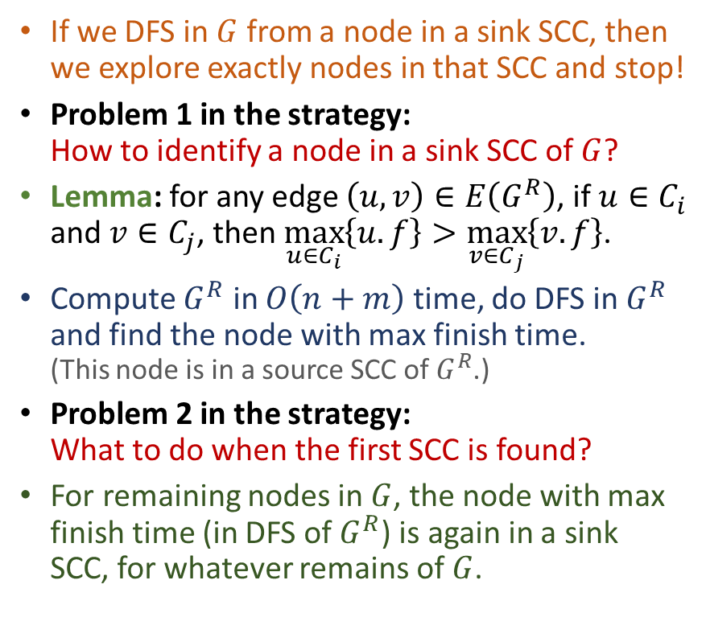
Computing SCC
If we DFS in $G$ from a node in a sink SCC, then we explore exactly nodes in that SCC and stop!
Problem 1 in the strategy: How to identify a node in a sink SCC of $G$?
Lemma: for any edge $\left(u,v\right)∈E\left(G^{R}\right)$, if $u∈C_{i}$ and $v∈C_{j}$, then $\max_{u∈C_{i}}\left\{u.f\right\}>\max_{v∈C_{j}}\left\{v.f\right\}$.
Compute $G^{R}$ in $O\left(n+m\right)$ time, do DFS in $G^{R}$ and find the node with max finish time. (This node is in a source SCC of $G^{R}$.)
Problem 2 in the strategy: What to do when the first SCC is found?
For remaining nodes in $G$, the node with max finish time (in DFS of $G^{R}$) is again in a sink SCC, for whatever remains of $G$.
$$G$$
A
B,E
C,F
G,H,I J,K,L
D
$$G^{C}$$
A
B,E
C,F
G,H,I J,K,L
D
$${\left(G^{R}\right)}^{C}$$

Slide 20
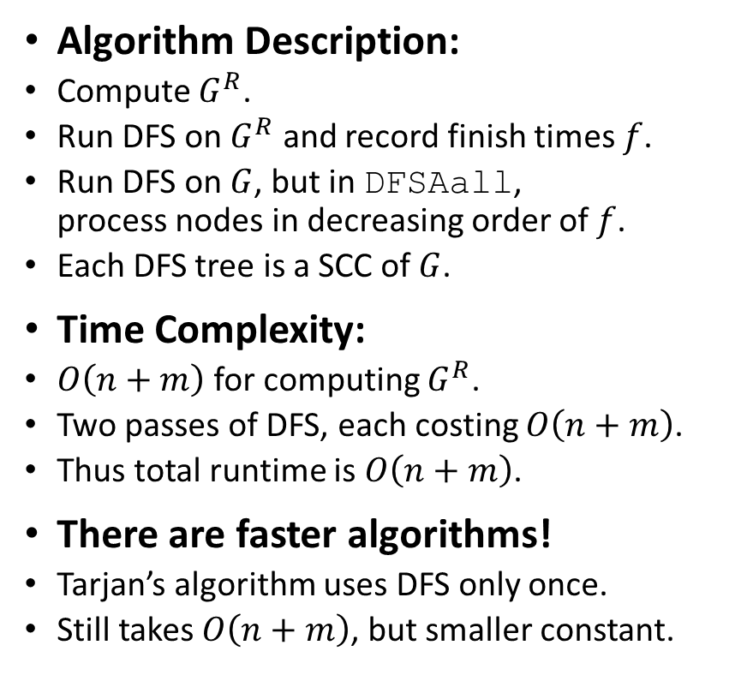
Computing SCC
Algorithm Description:
Compute $G^{R}$.
Run DFS on $G^{R}$ and record finish times $f$.
Run DFS on $G$, but in DFSAall, process nodes in decreasing order of $f$.
Each DFS tree is a SCC of $G$.
Time Complexity:
$O\left(n+m\right)$ for computing $G^{R}$.
Two passes of DFS, each costing $O\left(n+m\right)$.
Thus total runtime is $O\left(n+m\right)$.
There are faster algorithms!
Tarjan’s algorithm uses DFS only once.
Still takes $O\left(n+m\right)$, but smaller constant.
$$G$$
A
B,E
C,F
G,H,I J,K,L
D
$$G^{C}$$
A
B,E
C,F
G,H,I J,K,L
D
$${\left(G^{R}\right)}^{C}$$

Slide 21


*Tarjan’s SCC Algorithm
If we start from a node in a sink SCC, then we explore exactly nodes in that SCC and stop!
But how to find such a node?
Previous algorithm’s approach: A node in a source SCC in $G^{R}$ must be in a sink SCC in $G$.
Tarjan comes up with a method to identify a node in some sink SCC directly!
Robert Tarjan
American computer scientist and mathematician
Recipient of the 1986 Turing Award for “fundamental achievements in the design and analysis of algorithms and data structures”
(Such as linear time selection using median of medians, Fibonacci heap, first optimal analysis of the UnionFind data structure.)

Slide 22





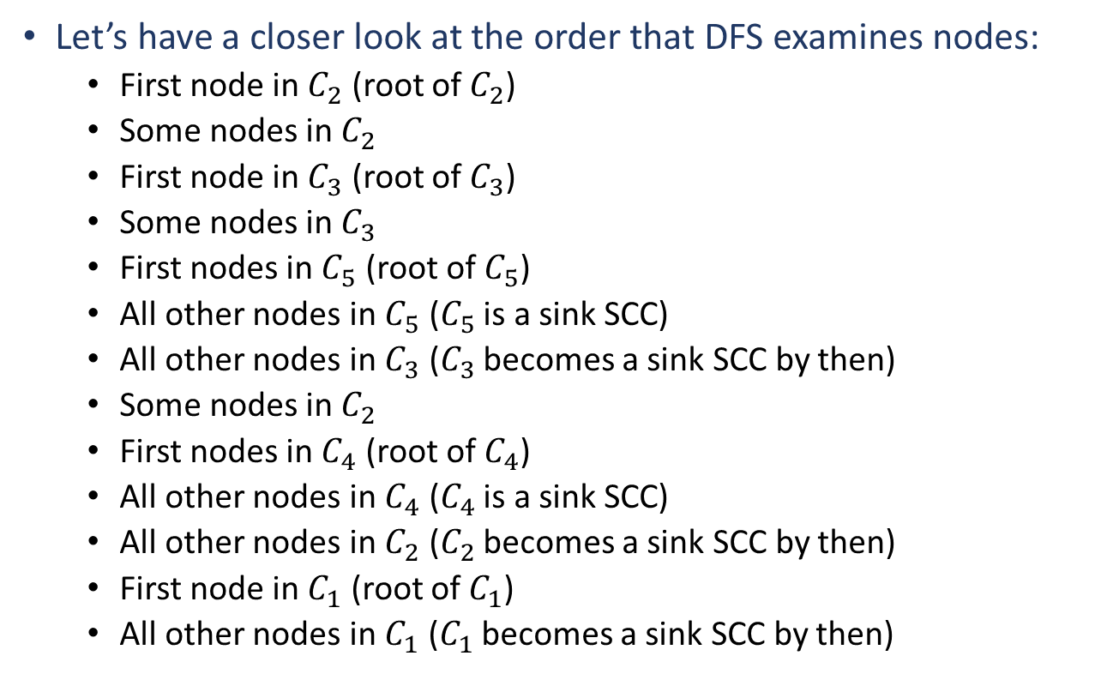
Tarjan’s SCC Algorithm
Let’s have a closer look at the order that DFS examines nodes:
First node in $C_{2}$ (root of $C_{2}$)
Some nodes in $C_{2}$
First node in $C_{3}$ (root of $C_{3}$)
Some nodes in $C_{3}$
First nodes in $C_{5}$ (root of $C_{5}$)
All other nodes in $C_{5}$ ($C_{5}$ is a sink SCC)
All other nodes in $C_{3}$ ($C_{3}$ becomes a sink SCC by then)
Some nodes in $C_{2}$
First nodes in $C_{4}$ (root of $C_{4}$)
All other nodes in $C_{4}$ ($C_{4}$ is a sink SCC)
All other nodes in $C_{2}$ ($C_{2}$ becomes a sink SCC by then)
First node in $C_{1}$ (root of $C_{1}$)
All other nodes in $C_{1}$ ($C_{1}$ becomes a sink SCC by then)
$$C_{1}$$
$$C_{2}$$
$C_{3}$
$$C_{5}$$
$$C_{4}$$

Slide 23
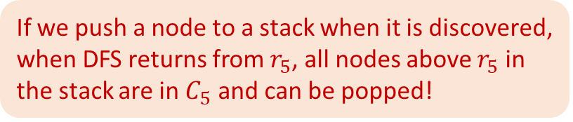
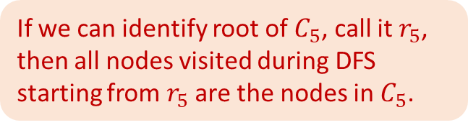




Tarjan’s SCC Algorithm
Let’s have a closer look at the order that DFS examines nodes:
First node in $C_{2}$ (root of $C_{2}$)
Some nodes in $C_{2}$
First node in $C_{3}$ (root of $C_{3}$)
Some nodes in $C_{3}$
First nodes in $C_{5}$ (root of $C_{5}$)
All other nodes in $C_{5}$ ($C_{5}$ is a sink SCC)
All other nodes in $C_{3}$ ($C_{3}$ becomes a sink SCC by then)
Some nodes in $C_{2}$
First nodes in $C_{4}$ (root of $C_{4}$)
All other nodes in $C_{4}$ ($C_{4}$ is a sink SCC)
All other nodes in $C_{2}$ ($C_{2}$ becomes a sink SCC by then)
First node in $C_{1}$ (root of $C_{1}$)
All other nodes in $C_{1}$ ($C_{1}$ becomes a sink SCC by then)
stack bottom
$$C_{1}$$
$$C_{2}$$
$C_{3}$
$$C_{5}$$
$$C_{4}$$
If we can identify root of $C_{5}$, call it $r_{5}$, then all nodes visited during DFS starting from $r_{5}$ are the nodes in $C_{5}$.
If we push a node to a stack when it is discovered, when DFS returns from $r_{5}$, all nodes above $r_{5}$ in the stack are in $C_{5}$ and can be popped!
stack top

Slide 24

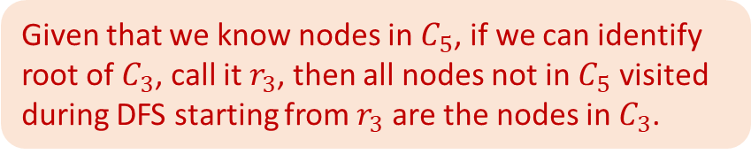


Tarjan’s SCC Algorithm
Let’s have a closer look at the order that DFS examines nodes:
First node in $C_{2}$ (root of $C_{2}$)
Some nodes in $C_{2}$
First node in $C_{3}$ (root of $C_{3}$)
Some nodes in $C_{3}$
First nodes in $C_{5}$ (root of $C_{5}$)
All other nodes in $C_{5}$ ($C_{5}$ is a sink SCC)
All other nodes in $C_{3}$ ($C_{3}$ becomes a sink SCC by then)
Some nodes in $C_{2}$
First nodes in $C_{4}$ (root of $C_{4}$)
All other nodes in $C_{4}$ ($C_{4}$ is a sink SCC)
All other nodes in $C_{2}$ ($C_{2}$ becomes a sink SCC by then)
First node in $C_{1}$ (root of $C_{1}$)
All other nodes in $C_{1}$ ($C_{1}$ becomes a sink SCC by then)
stack bottom
$$C_{1}$$
$$C_{2}$$
$C_{3}$
$$C_{5}$$
$$C_{4}$$
Given that we know nodes in $C_{5}$, if we can identify root of $C_{3}$, call it $r_{3}$, then all nodes not in $C_{5}$ visited during DFS starting from $r_{3}$ are the nodes in $C_{3}$.
If we push a node to a stack when it is discovered, when DFS returns from $r_{3}$, all nodes above $r_{3}$ in the stack are in $C_{3}$ and can be popped!
stack top

Slide 25

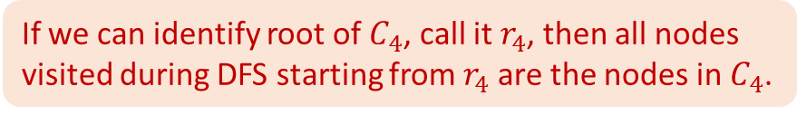


Tarjan’s SCC Algorithm
Let’s have a closer look at the order that DFS examines nodes:
First node in $C_{2}$ (root of $C_{2}$)
Some nodes in $C_{2}$
First node in $C_{3}$ (root of $C_{3}$)
Some nodes in $C_{3}$
First nodes in $C_{5}$ (root of $C_{5}$)
All other nodes in $C_{5}$ ($C_{5}$ is a sink SCC)
All other nodes in $C_{3}$ ($C_{3}$ becomes a sink SCC by then)
Some nodes in $C_{2}$
First nodes in $C_{4}$ (root of $C_{4}$)
All other nodes in $C_{4}$ ($C_{4}$ is a sink SCC)
All other nodes in $C_{2}$ ($C_{2}$ becomes a sink SCC by then)
First node in $C_{1}$ (root of $C_{1}$)
All other nodes in $C_{1}$ ($C_{1}$ becomes a sink SCC by then)
stack bottom
$$C_{1}$$
$$C_{2}$$
$C_{3}$
$$C_{5}$$
$$C_{4}$$
If we can identify root of $C_{4}$, call it $r_{4}$, then all nodes visited during DFS starting from $r_{4}$ are the nodes in $C_{4}$.
If we push a node to a stack when it is discovered, when DFS returns from $r_{4}$, all nodes above $r_{4}$ in the stack are in $C_{4}$ and can be popped!
stack top

Slide 26

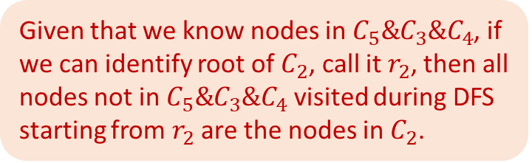


Tarjan’s SCC Algorithm
Let’s have a closer look at the order that DFS examines nodes:
First node in $C_{2}$ (root of $C_{2}$)
Some nodes in $C_{2}$
First node in $C_{3}$ (root of $C_{3}$)
Some nodes in $C_{3}$
First nodes in $C_{5}$ (root of $C_{5}$)
All other nodes in $C_{5}$ ($C_{5}$ is a sink SCC)
All other nodes in $C_{3}$ ($C_{3}$ becomes a sink SCC by then)
Some nodes in $C_{2}$
First nodes in $C_{4}$ (root of $C_{4}$)
All other nodes in $C_{4}$ ($C_{4}$ is a sink SCC)
All other nodes in $C_{2}$ ($C_{2}$ becomes a sink SCC by then)
First node in $C_{1}$ (root of $C_{1}$)
All other nodes in $C_{1}$ ($C_{1}$ becomes a sink SCC by then)
stack bottom
$$C_{1}$$
$$C_{2}$$
$C_{3}$
$$C_{5}$$
$$C_{4}$$
Given that we know nodes in $C_{5}\&C_{3}\&C_{4}$, if we can identify root of $C_{2}$, call it $r_{2}$, then all nodes not in $C_{5}\&C_{3}\&C_{4}$ visited during DFS starting from $r_{2}$ are the nodes in $C_{2}$.
If we push a node to a stack when it is discovered, when DFS returns from $r_{2}$, all nodes above $r_{2}$ in the stack are in $C_{2}$ and can be popped!
stack top

Slide 27

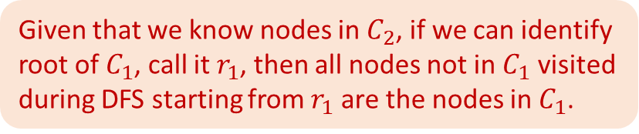


Tarjan’s SCC Algorithm
Let’s have a closer look at the order that DFS examines nodes:
First node in $C_{2}$ (root of $C_{2}$)
Some nodes in $C_{2}$
First node in $C_{3}$ (root of $C_{3}$)
Some nodes in $C_{3}$
First nodes in $C_{5}$ (root of $C_{5}$)
All other nodes in $C_{5}$ ($C_{5}$ is a sink SCC)
All other nodes in $C_{3}$ ($C_{3}$ becomes a sink SCC by then)
Some nodes in $C_{2}$
First nodes in $C_{4}$ (root of $C_{4}$)
All other nodes in $C_{4}$ ($C_{4}$ is a sink SCC)
All other nodes in $C_{2}$ ($C_{2}$ becomes a sink SCC by then)
First node in $C_{1}$ (root of $C_{1}$)
All other nodes in $C_{1}$ ($C_{1}$ becomes a sink SCC by then)
stack bottom
$$C_{1}$$
$$C_{2}$$
$C_{3}$
$$C_{5}$$
$$C_{4}$$
Given that we know nodes in $C_{2}$, if we can identify root of $C_{1}$, call it $r_{1}$, then all nodes not in $C_{1}$ visited during DFS starting from $r_{1}$ are the nodes in $C_{1}$.
If we push a node to a stack when it is discovered, when DFS returns from $r_{1}$, all nodes above $r_{1}$ in the stack are in $C_{1}$ and can be popped!
stack top

Slide 28

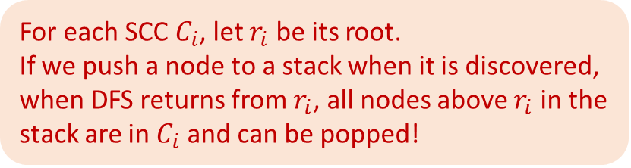
Tarjan’s SCC Algorithm
Let’s have a closer look at the order that DFS examines nodes:
First node in $C_{2}$ (root of $C_{2}$)
Some nodes in $C_{2}$
First node in $C_{3}$ (root of $C_{3}$)
Some nodes in $C_{3}$
First nodes in $C_{5}$ (root of $C_{5}$)
All other nodes in $C_{5}$ ($C_{5}$ is a sink SCC)
All other nodes in $C_{3}$ ($C_{3}$ becomes a sink SCC by then)
Some nodes in $C_{2}$
First nodes in $C_{4}$ (root of $C_{4}$)
All other nodes in $C_{4}$ ($C_{4}$ is a sink SCC)
All other nodes in $C_{2}$ ($C_{2}$ becomes a sink SCC by then)
First node in $C_{1}$ (root of $C_{1}$)
All other nodes in $C_{1}$ ($C_{1}$ becomes a sink SCC by then)
stack bottom
$$C_{1}$$
$$C_{2}$$
$C_{3}$
$$C_{5}$$
$$C_{4}$$
For each SCC $C_{i}$, let $r_{i}$ be its root.
If we push a node to a stack when it is discovered, when DFS returns from $r_{i}$, all nodes above $r_{i}$ in the stack are in $C_{i}$ and can be popped!
But how to identify each root $r_{i}$?
stack top

Slide 29
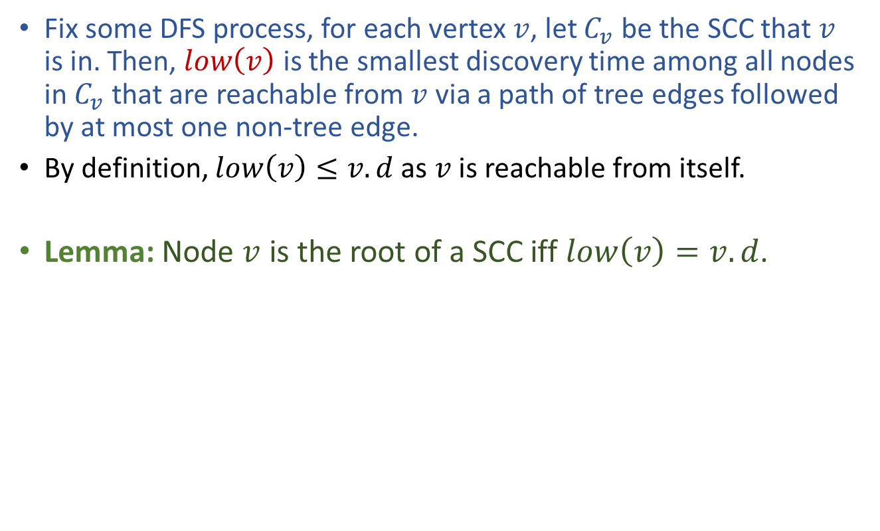
Tarjan’s method to identify root of SCC
Fix some DFS process, for each vertex $v$, let $C_{v}$ be the SCC that $v$ is in. Then, $low\left(v\right)$ is the smallest discovery time among all nodes in $C_{v}$that are reachable from $v$ via a path of tree edges followed by at most one non-tree edge.
By definition, $low\left(v\right)≤v.d$ as $v$ is reachable from itself.
Lemma: Node $v$ is the root of a SCC iff $low\left(v\right)=v.d$.

Slide 30
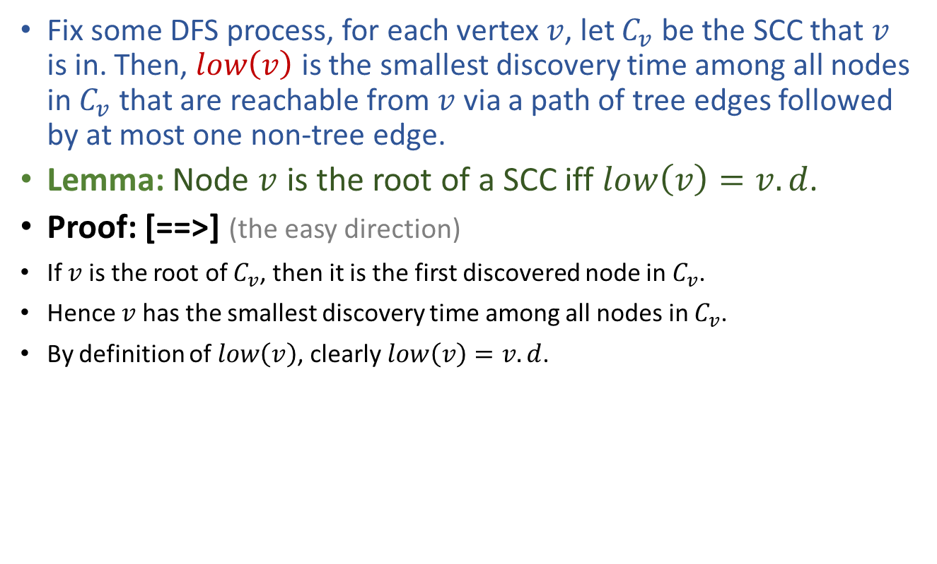
Tarjan’s method to identify root of SCC
Fix some DFS process, for each vertex $v$, let $C_{v}$ be the SCC that $v$ is in. Then, $low\left(v\right)$ is the smallest discovery time among all nodes in $C_{v}$that are reachable from $v$ via a path of tree edges followed by at most one non-tree edge.
Lemma: Node $v$ is the root of a SCC iff $low\left(v\right)=v.d$.
Proof: [==>] (the easy direction)
If $v$ is the root of $C_{v}$, then it is the first discovered node in $C_{v}$.
Hence $v$ has the smallest discovery time among all nodes in $C_{v}$.
By definition of $low\left(v\right)$, clearly $low\left(v\right)=v.d$.

Slide 31
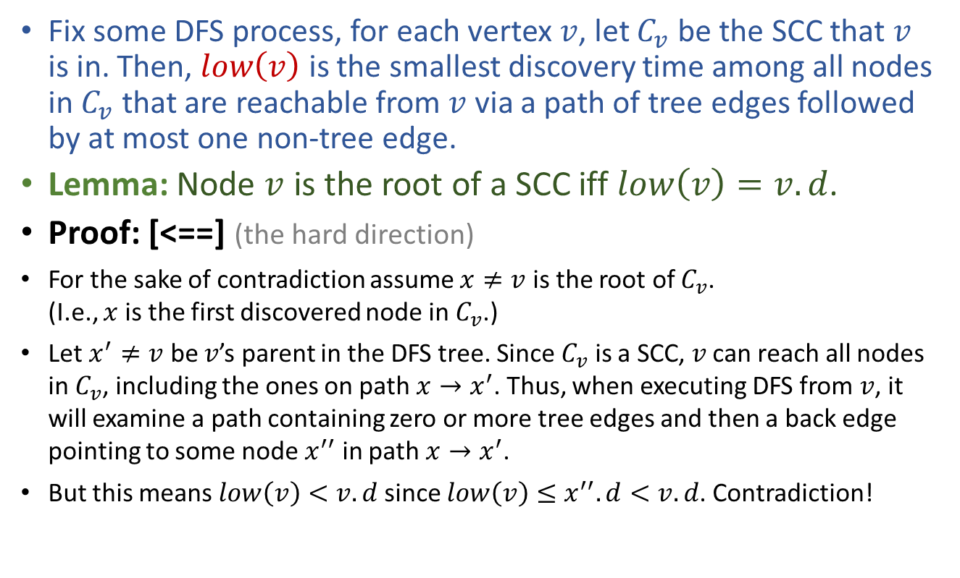
Tarjan’s method to identify root of SCC
Fix some DFS process, for each vertex $v$, let $C_{v}$ be the SCC that $v$ is in. Then, $low\left(v\right)$ is the smallest discovery time among all nodes in $C_{v}$that are reachable from $v$ via a path of tree edges followed by at most one non-tree edge.
Lemma: Node $v$ is the root of a SCC iff $low\left(v\right)=v.d$.
Proof: [<==] (the hard direction)
For the sake of contradiction assume $x≠v$ is the root of $C_{v}$. (I.e., $x$ is the first discovered node in $C_{v}$.)
Let $x^{′}≠v$ be $v$’s parent in the DFS tree. Since $C_{v}$ is a SCC, $v$ can reach all nodes in $C_{v}$, including the ones on path $x→x^{′}$. Thus, when executing DFS from $v$, it will examine a path containing zero or more tree edges and then a back edge pointing to some node $x^{′′}$ in path $x→x^{′}$.
But this means $low\left(v\right)<v.d$ since $low\left(v\right)≤x^{′′}.d<v.d$. Contradiction!

Slide 32
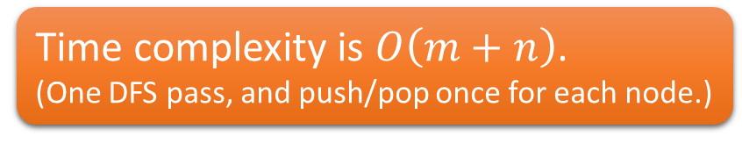
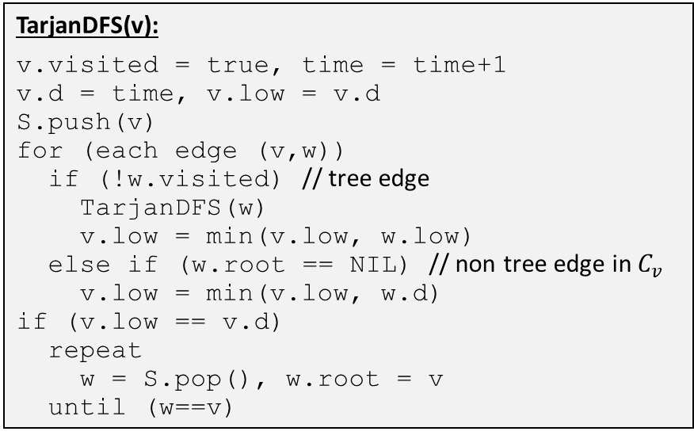
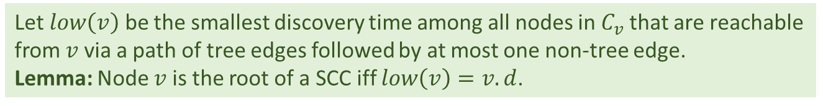
Tarjan’s SCC Algorithm
For each SCC $C_{i}$, let $r_{i}$ be its root. If we push a node to a stack when it is discovered, when DFS returns from $r_{i}$, all nodes above $r_{i}$ in the stack are in $C_{i}$.
Let $low\left(v\right)$ be the smallest discovery time among all nodes in $C_{v}$that are reachable from $v$ via a path of tree edges followed by at most one non-tree edge. Lemma: Node $v$ is the root of a SCC iff $low\left(v\right)=v.d$.
Tarjan(G):
time = 0
Let S be a stack
for (each node v)
v.root = NIL
v.visited = false
for (each node v)
if (!v.visited)
TarjanDFS(v)
TarjanDFS(v):
v.visited = true, time = time+1
v.d = time, v.low = v.d
S.push(v)
for (each edge (v,w))
if (!w.visited) // tree edge
TarjanDFS(w)
v.low = min(v.low, w.low)
else if (w.root == NIL) // non tree edge in $C_{v}$
v.low = min(v.low, w.d)
if (v.low == v.d)
repeat
w = S.pop(), w.root = v
until (w==v)
Time complexity is $O\left(m+n\right)$.
(One DFS pass, and push/pop once for each node.)

Slide 33
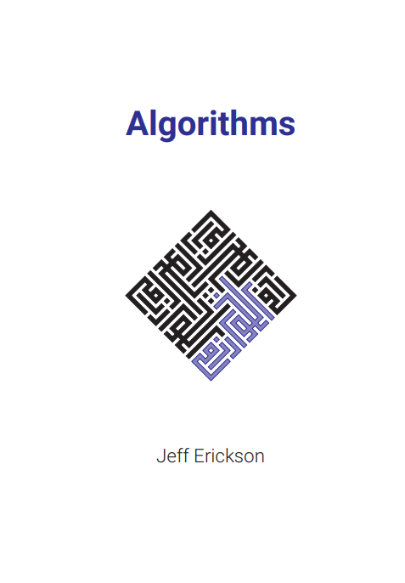
Reading
[CLRS] Ch.22 (22.4-22.5)
*If you want to know more about Tarjan’s SCC algorithm:
[Erickson v1] Ch.6 (6.6)
Tarjan’s original paper entitled “Depth-First Search and Linear Graph Algorithms” (https://doi.org/10.1137/0201010)

